Slide 1
The Rod Cutting Problem
Zachary Nelson
Ethan Bilyk

Slide 2
A Brief Intro
Implementing a solution to the Rod-Cutting problem led our group to answer three different questions:
Why a Dynamic Programming Solution may be needed
What ways a Dynamic Programming solution may be implemented
When a Dynamic Programming solution may be beneficial in similar projects

Slide 3
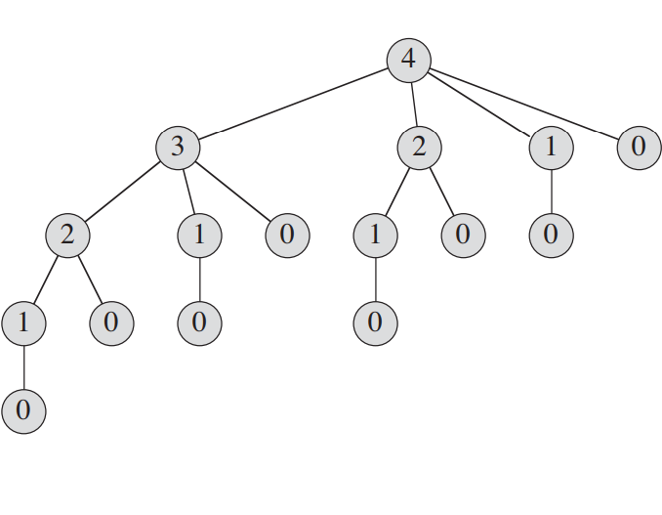
Problems with Naïve Recursion
Within each recursive step all previous recursive steps are iterated through to find the maximum revenue.
Solutions for subproblems are re-computed multiple times.
As all 2^(N-1) ways to cut a rod are considered (as shown by the graph), the running complexity of the program has an upper bound of O(2^N) for a rod of length N.

Slide 4
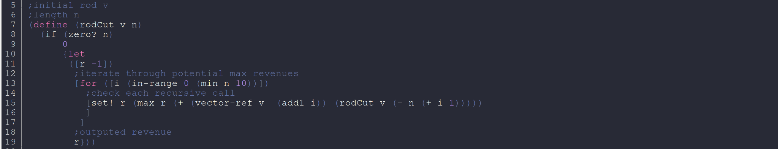
Recursive Implementation

Slide 5
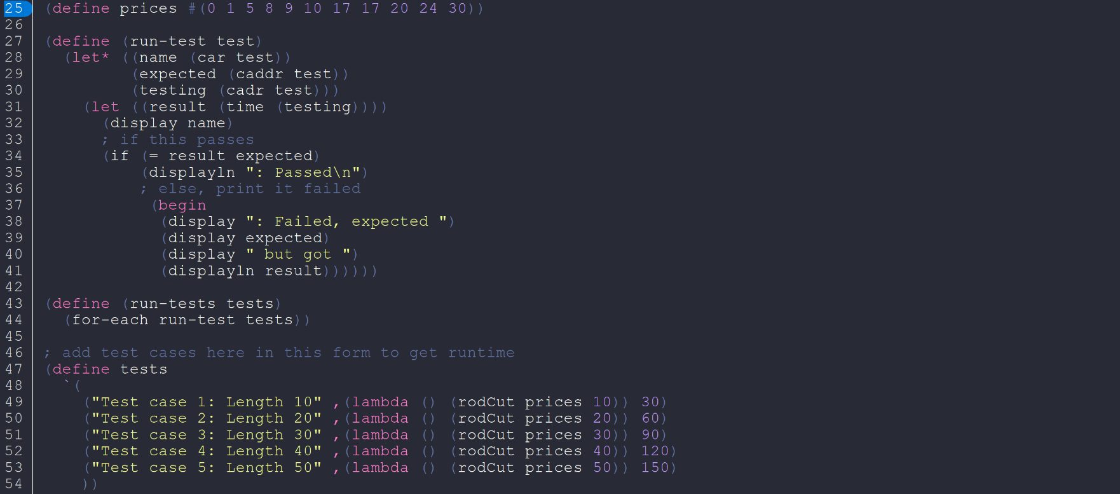
Testing Function Implementation

Slide 6
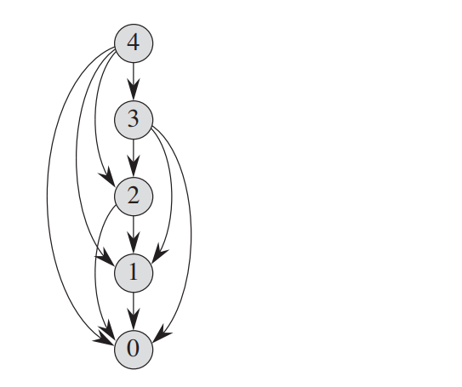
Dynamic Programing Features
A Dynamic Programming solution can drastically reduce running time by using additional memory.
Subproblems are solved once and saved (usually in a table) to be referenced later.
As previous solutions to subproblems can referenced (as shown in the graph) the running complexity of the program has an upper bound of only O(N^2) for a rod of length N

Slide 7
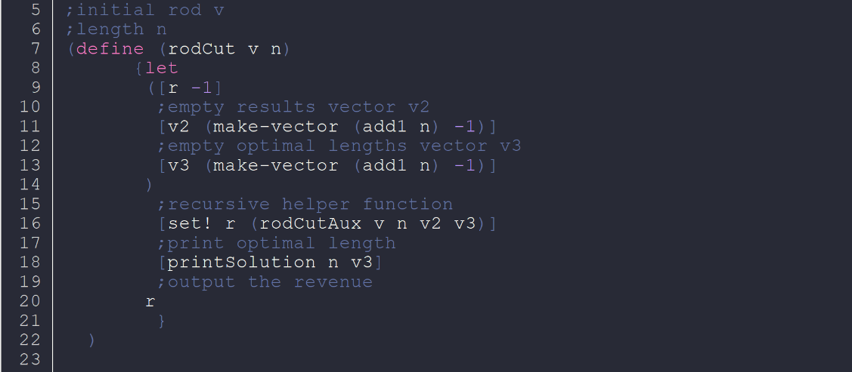
Dynamic Programing Implementation

Slide 8
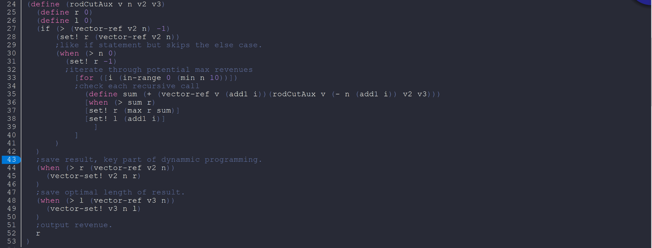
Auxiliary Function Implementation

Slide 9
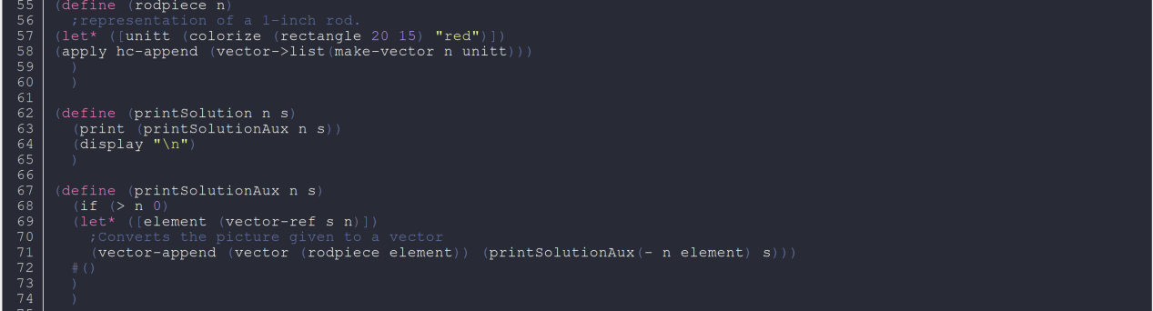
Display Function Implementation

Slide 10
When to Consider Dynamic Programing
The Rod-Cutting problem has optimal substructure: optimal solutions are comprised of optimal solutions to subproblems.
When dealing with independent subproblems and subproblems that overlap, Dynamic Programming can be used.
While Divide-and-Conquer can be used for several applications, Dynamic Programming is can greatly simplify the Rod-Cutting problem and many problems like it.

Slide 11
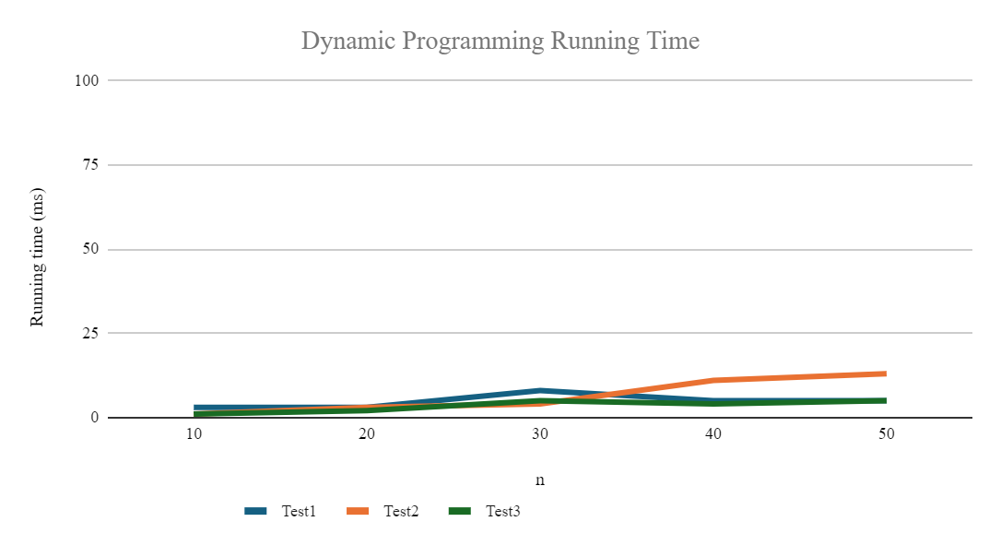
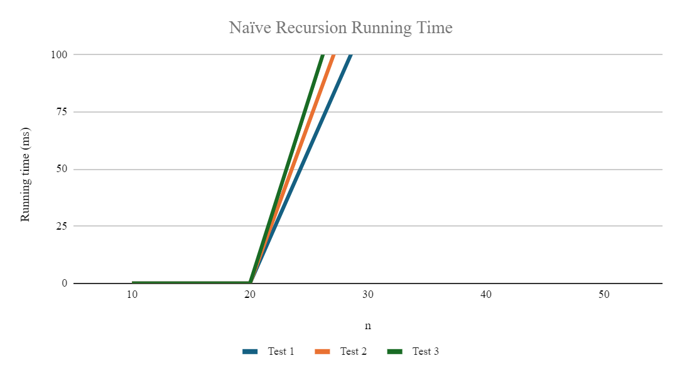
Graph of Running Time

Slide 12
Graph of Running Time
 | Dynamic | Programming
n | Test 1 Runtime (ms) | Test 2 runtime (ms) | Test 3 runtime (ms)
10 | 3 | 1 | 1
20 | 3 | 3 | 2
30 | 8 | 4 | 5
40 | 5 | 11 | 4
50 | 5 | 13 | 5
 | Naïve Recursion
n | Test 1 Runtime (ms) | Test 2 runtime (ms) | Test 3 runtime (ms)
10 | 0 | 0 | 0
20 | 0 | 0 | 0
30 | 117 | 141 | 162
40 | 12733 | 12464 | 11993
50 | 1431026 | 1403022 | 1435057

Slide 13
Retrospective
Problems of exponential time such as the Rod-Cutting problem can drastically increase their running time.
Racket can implement iterative and recursive procedures alike.
Racket has additional testing functions such as (test) and (time).
How to structure an optimal solution for a related problem.

